Slide 1
Predicting the Accuracy in ICC Men's Cricket World Cup
A Data Warehousing, Mining & Visualization Project
Error 404: Team Not Found

Slide 2

Overview
Introduction to Cricket
International Cricket Council’s Cricket World Cup
Cricket Analytics - Statistics & Actuarial Science
Improvement in Decision Making
Related Work
Exploratory Analysis
Predictive Analysis
Conclusion

Slide 3

Introduction to Cricket
Cricket - a bat & ball game played between two teams of eleven players on a field at the centre of which is a 20-metre (22-yard) pitch with a wicket at each end, each comprising of two bails balanced on three stumps.
Cricket is played across various formats ranging from Twenty-20, One Day International Matches to Test Matches, played over five days with unlimited overs and the teams each batting for two innings of unlimited length.
The International Cricket Council (ICC), has its headquarters in Dubai, is the global governing body of cricket.

Slide 4
ICC Men’s Cricket World Cup
The ICC Cricket World Cup is the International Championship of One Day International (ODI) Cricket.
The event is organised by the sport's governing body, the International Cricket Council (ICC), every four years, with first qualification rounds leading up to a semifinals and then finals tournament.
The World Cup is open to all members of the International Cricket Council (ICC), although the highest-ranking teams receive automatic qualification. The remaining teams are determined via the World Cricket League and the ICC World Cup Qualifier.
https://en.wikipedia.org/wiki/Cricket_World_Cup

Slide 5
ICC is responsible for the organisation and governance of cricket's major international tournaments, notably the men's and women's versions of the Cricket World Cup.
The ICC Men’s Cricket World Cup is one of the world’s most viewed sporting event and is considered the “ Flagship Event of the International Cricket Calendar ” organized by ICC.

Slide 6
Cricket Analytics - Statistics
Data mining is one of the widely used techniques for finding hidden patterns from voluminous data.
Cricket is considered today as one of the major world sports in terms of participants, spectators and media interest.
Although it originates from England, cricket did not attract much interest and attention in Europe like football did.
However it became hugely popular in countries such as India, Pakistan, Sri Lanka, Bangladesh, South Africa, Australia, New Zealand and West Indies, most of them former British colonies or still under the Crown influence.

Slide 7
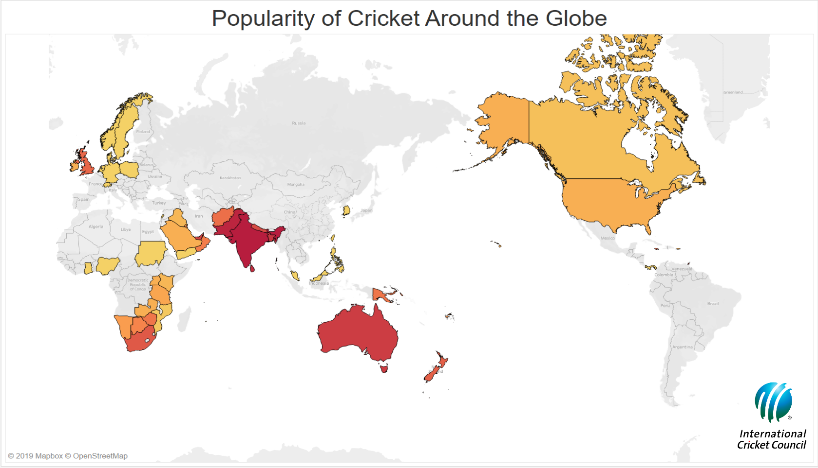

Slide 8
Cricket Analytics - Role of Analytics & Actuarial Science
The role of analytics in Cricket World Cup’s are
Strategizing:
The data analytics team analyses the past data pertaining to a variety of factors like the scores, performances etc. to come up with ideal team line-ups and answer important questions like who should bat at No. 5 when the team is struggling in the middle overs or which bowler should bowl the last over.
In- depth Analysis of Match Patterns & Performances:
A technique called WASP (Winning and Scoring Prediction), predicts the score in first innings and deciphers the chasing team’s chances of winning the game. WASP uses average run rates in the first innings to predict the total and predicts chasing team’s chances of winning the match using the same data.
https://talentedge.com/blog/role-big-data-analytics-cricket-world-cup-2019-howsstat/

Slide 9
Cricket Analytics - Role of Analytics & Actuarial Science
Entertaining the Fans:
The statistical data related to a match and performance of players like wickets remaining, the swing of the ball, required and current run rates, wagon wheels etc. allows the fans to understand the game in-depth and also provides ammunition to the commentators to keep the fans engaged.
Help the Captain make Informed Decisions:
Data science can be of great help to the captain in critical situations. With the use of various statistical tools and trained machine learning models, the probability of a particular player’s performance can be assessed under specific conditions.
https://medium.com/@springboard_ind/use-of-data-science-in-the-game-of-cricket-ace3fa41c14b

Slide 10
Related Work
We have chosen Linear Regression as it is very much flexible in predictive modeling.
Prediction of the four editions of World Cups (2007-2019) and finding the best attributes that influence the match outcome is a tough task.
We have used Linear regression on predicting an outcome of one-day matches played between two teams and to predict the result of a ICC tournament depending on the past 13 years data.
We have used Linear regression to predict the accuracy based on Consistency, Form.

Slide 11
We have collected data by averaging the runs, no of innings, strike rate, no of centuries, no of fifties and no of zeros from espncricinfo.com
It was a very lengthy procedure, which had data for 12 editions of Cricket World Cup. So in future, we will work on to develop a web crawler which can crawl data according to our attributes selection and needs.

Slide 12
Improvement in Decision Making
There are still a lot of space for improvement in our decision making. In future, we want to design a model which is much more efficient, significant and gives a minor error in predicting the winner of the next edition of World Cup.
Our model cannot handle the result of the matches which are interrupted by rain or other natural calamities. We like to improve on that with the help of Duckworth-Lewis method.
In our model, we have divided a match in four models in order to make our work easier. Our work to improve will be to design a model which can perform prediction in every over basis.

Slide 13
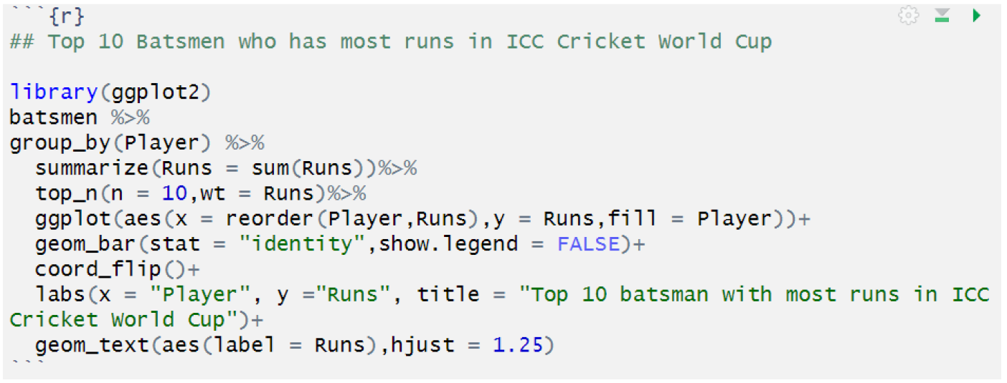
Exploratory Analysis
Visualisation for Top 10 batsmen who has most runs in ICC Cricket World Cup

Slide 14
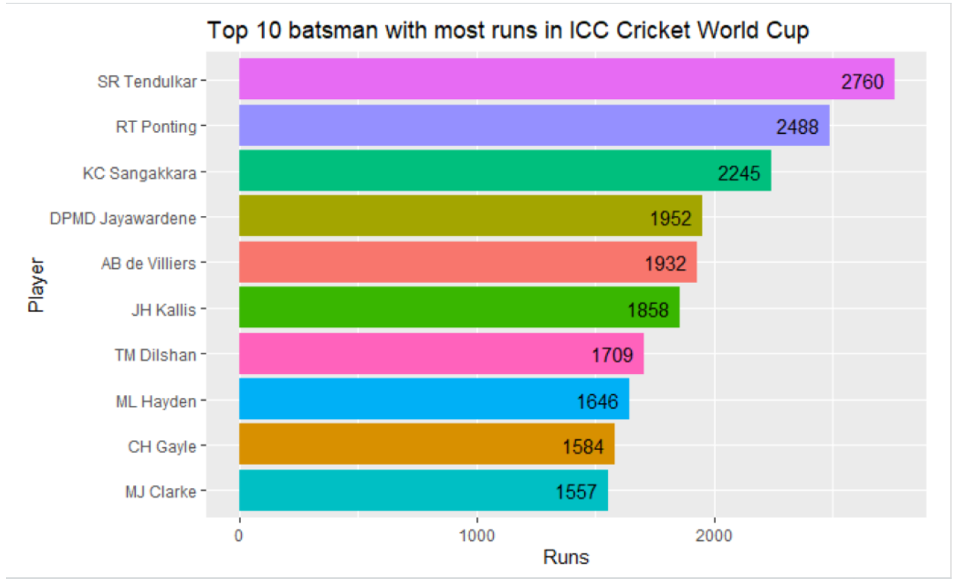

Slide 15
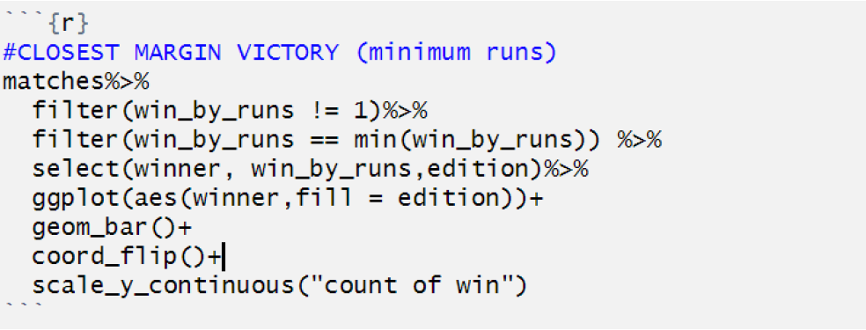
Visualisation for Closest Margin Victory - in terms on runs

Slide 16
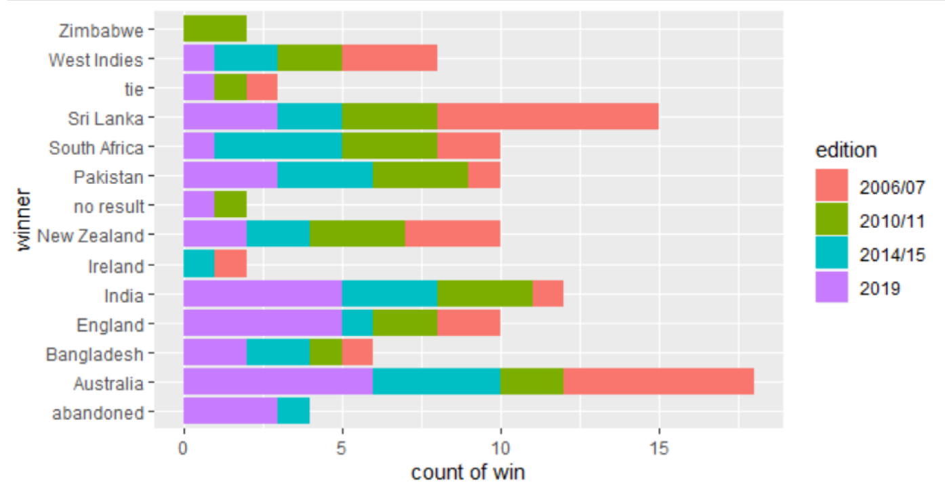

Slide 17
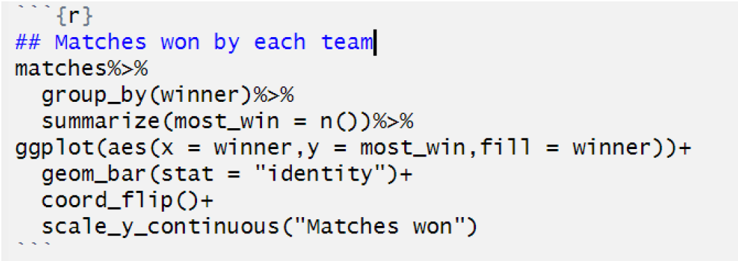
Visualisation for Matches won by each team in ICC World Cups

Slide 18
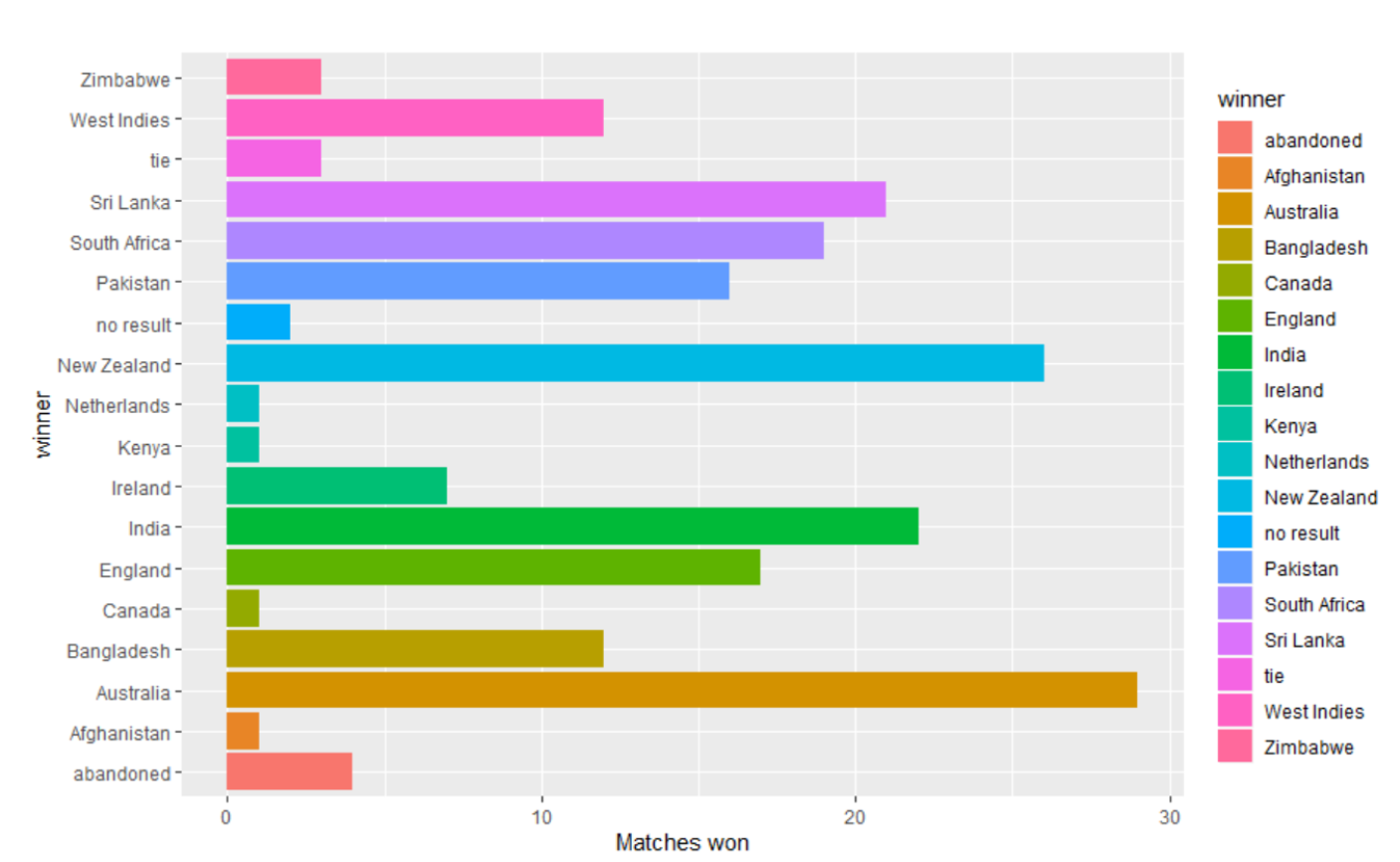

Slide 19
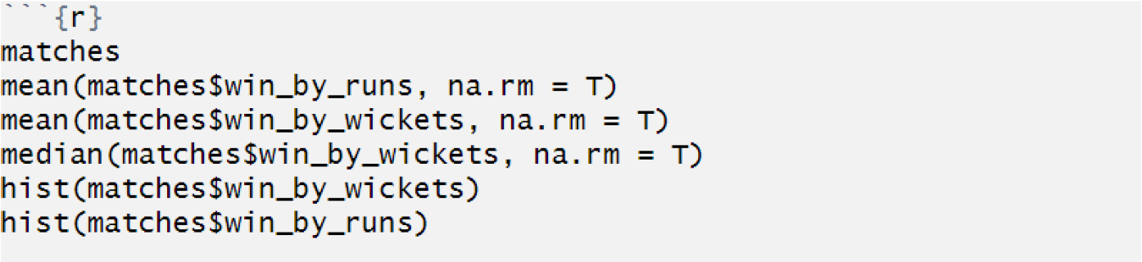
Histogram - Win By Runs

Slide 20
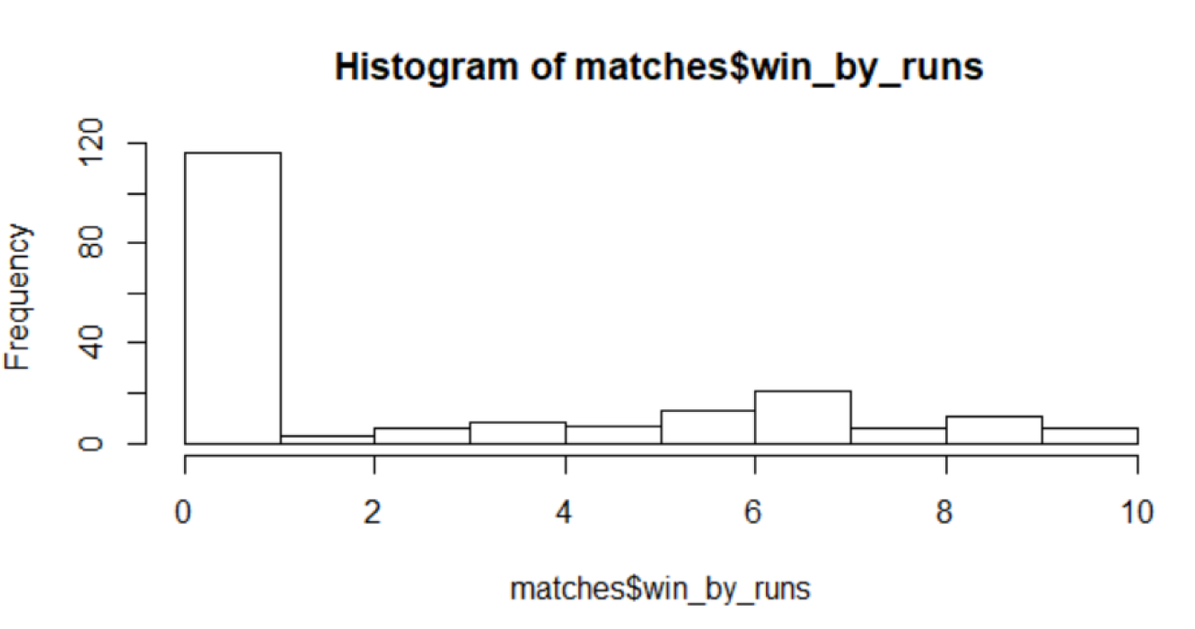

Slide 21
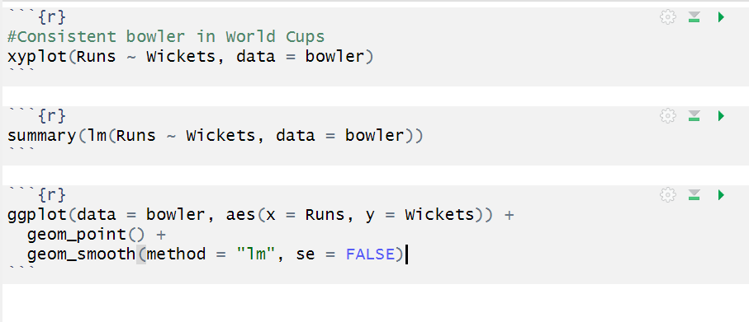
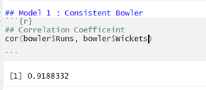
Predictive Analysis
#Model 1: Consistent Bowler in World Cups

Slide 22
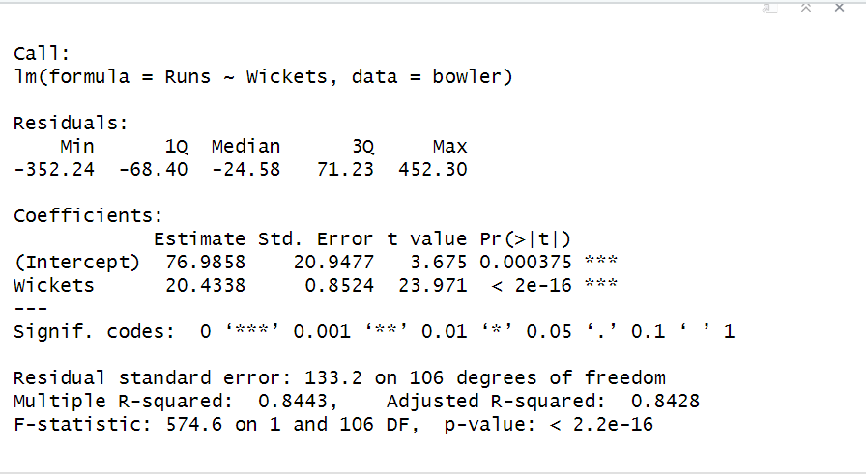
Predictive Analysis
#Model 1: Consistent Bowler in World Cups

Slide 23
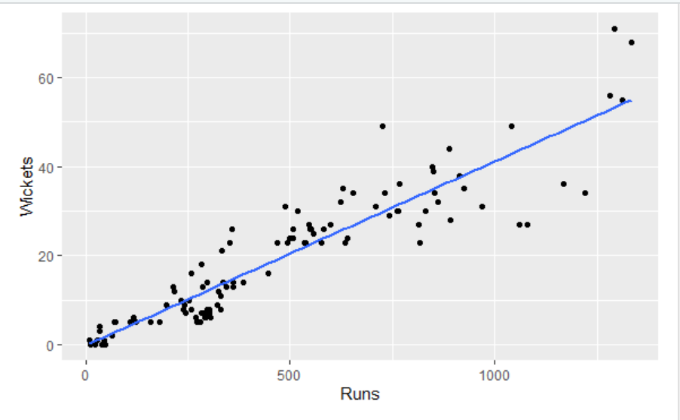
Predictive Analysis
#Model 1: Consistent Bowler in World Cups

Slide 24
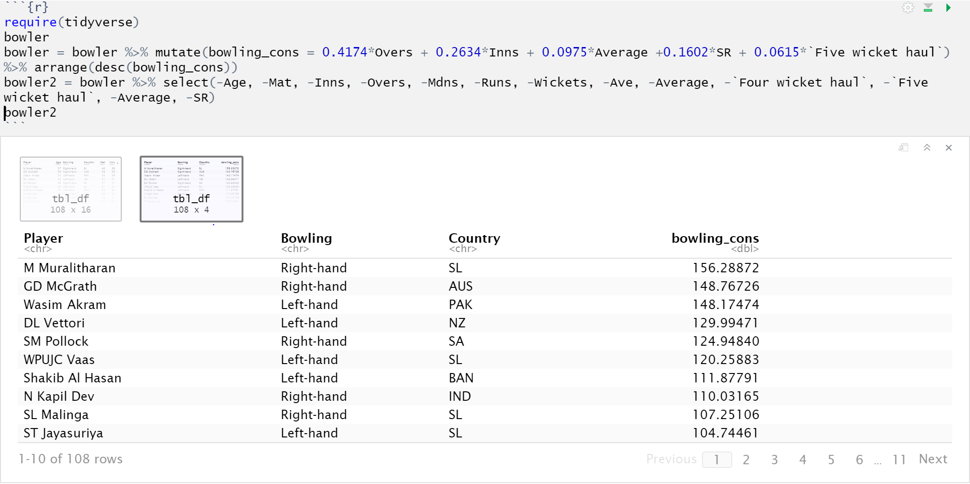
Predictive Analysis
#Model 1: Consistent Bowler in World Cups

Slide 25
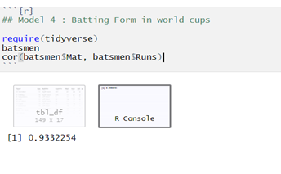
Predictive Analysis
#Model 2: Batting Form in World Cups

Slide 26
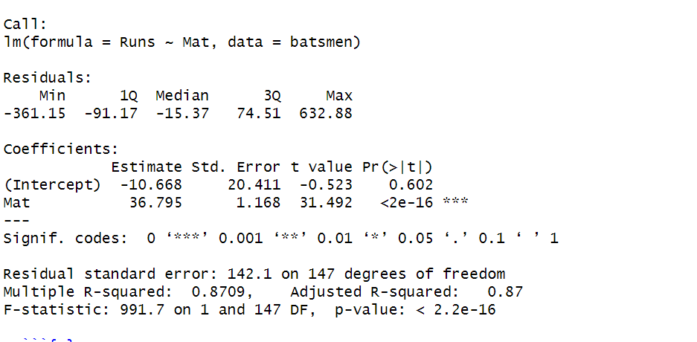
Predictive Analysis
#Model 2: Batting Form in World Cups

Slide 27
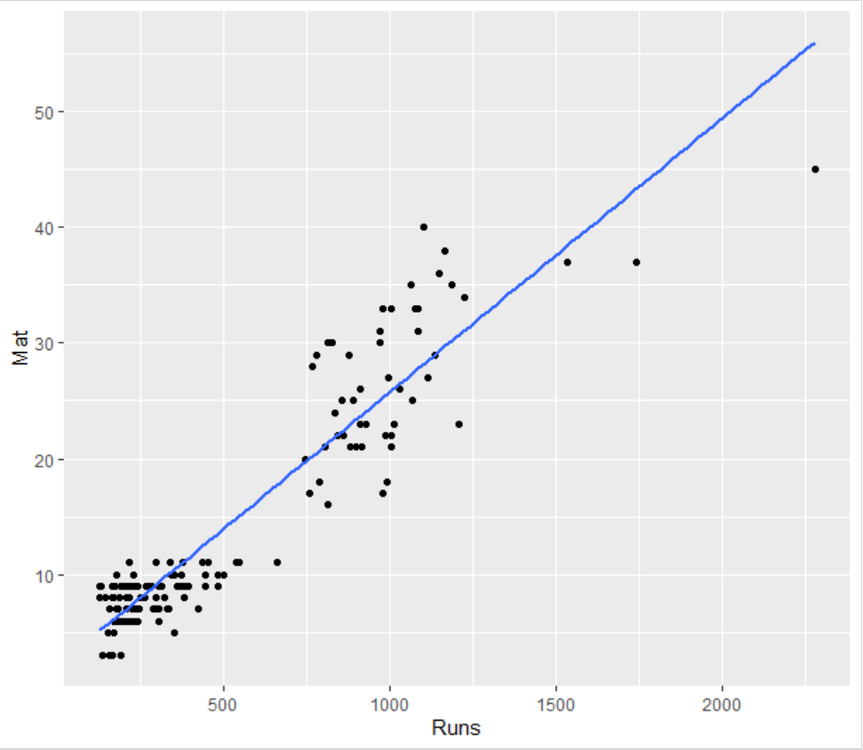
Predictive Analysis
#Model 2: Batting Form in World Cups

Slide 28
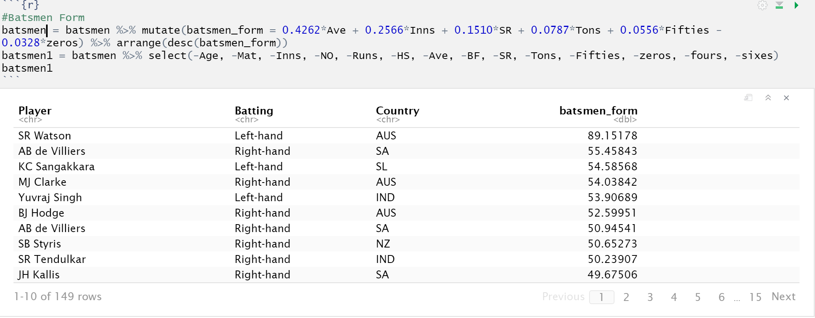
Predictive Analysis
#Model 2: Batting Form in World Cups

Slide 29
Conclusion
Our main goal in this project is to develop a model to predict the outcome of ICC Cricket World Cup matches from the period (2007-2019)
We have used the data based on batsmen, bowler and matches being played throughout the four World Cups.
Also, we have used linear regression model to establish the relationship between two numerical variables using scatter plots and quantifying the relationship using Correlation to strengthen the relationship between two variables.
This knowledge will help us in the future to design a better prediction model.

Slide 30
The Team
Anup Savant
Manali Gaikwad
Shraddha Sawant
Udayan Sawant
Submitted To -
Prof. Yegin Genc
Assistant Professor, Pace University
Seidenberg School of Computer Science & Information System
Department of Information Systems

